Slide 1



Slide 2

Welcome & Overview
Welcome to College for Arts and Technology
Introduction to Kelowna and our Campus
Overview of Orientation Goals: Academic Success, Cultural Adjustment, and Support
Notes:
Welcome to the College for Arts and Technology! My name is [Your Name], and I’m [Your Position]. It’s wonderful to have you here as part of our international student community.
This orientation is about giving you the tools, resources, and confidence to thrive academically, socially, and personally while you study here.
We’ll talk about living in Kelowna, understanding your program, Canadian classroom expectations, and where to go for help.
Please ask questions throughout — if you’re wondering about something, chances are others are too.
By the end of today, you’ll know where to find information, who to contact for support, and how to set yourself up for success here at CAT.

Slide 3
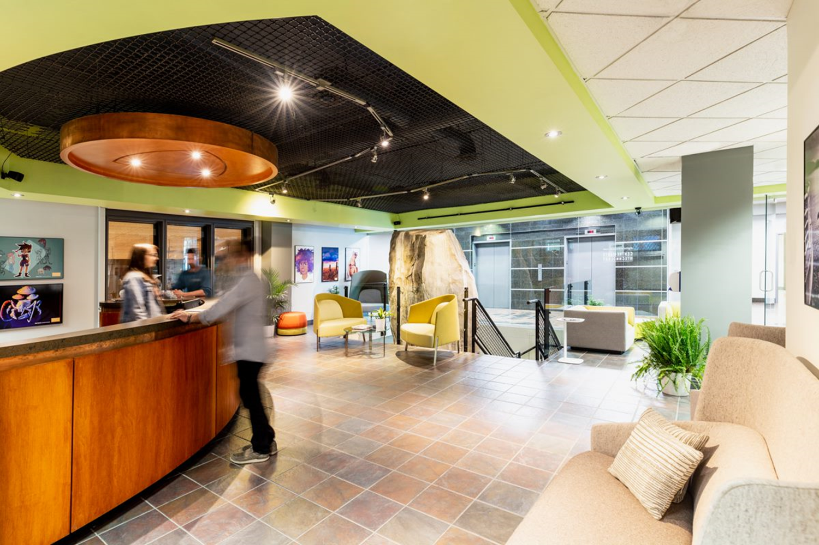
About Our College & City
College history and mission
Kelowna: location, climate, lifestyle
Why students choose to study here
Notes:
College for Arts and Technology is known for small class sizes, industry-experienced instructors, and strong support for students. Our Mission is to “Empower through Education.”
Kelowna is located in the Okanagan Valley — known for its beautiful scenery, mild winters, and a vibrant arts and tech community.
It’s a safe and welcoming city for students, with opportunities for both study and recreation — from lakes and hiking trails to cultural events.
We’re excited for you to be part of this city and community.

Slide 4


Daily Life in Kelowna
Transportation: BC Transit, student discounts, cycling, walking
Childcare: Kelowna Child Care Society, local providers
Communications: mobile & internet providers, setup tips
Banking: opening a bank account, major local banks
Cost of living examples: housing, groceries, transit
Notes:
Settling into a new city means learning how to get around and take care of everyday needs.
Transportation: BC Transit buses connect most parts of Kelowna. Monthly student passes are available. Biking and walking are also great options — we have lots of bike lanes.
Childcare: If you have children, the Kelowna Child Care Society is a great starting point to find licensed care.
Communications: You can choose from mobile providers like Telus, Rogers, Bell, or Freedom Mobile. Setting up a plan requires ID and sometimes proof of address.
Banking: Major banks like RBC, TD, CIBC, BMO, and Scotiabank have branches here. You’ll need ID and proof of enrollment to open an account.
Cost of Living: We recommend budgeting for housing, groceries, transportation, and other personal expenses. This will help you manage your finances while you’re here.

Slide 5

Housing & Tenancy Rights
Finding housing: rentals, homestays, online listings
Tenancy rights in BC (Residential Tenancy Branch)
https://www2.gov.bc.ca/gov/content/housing-tenancy/residential-tenancies
Avoiding rental scams
Living with roommates: agreements and expectations
Notes:
Finding a safe, comfortable place to live is a priority.
Housing options include rental apartments, shared housing with roommates, and homestays.
In BC, tenants have legal protections under the Residential Tenancy Act — it’s important to know your rights and responsibilities.
Always view a place before paying a deposit, and be cautious of online rental scams.
If you live with roommates, set agreements about bills, cleaning, and quiet hours to avoid conflicts.

Slide 6

Immigration, Work, and PGWP
Study permit conditions: maintaining full-time status
Working while studying: permitted hours and types of work
Contact licensed immigration consultants/lawyers for advice
Notes:
You must follow the conditions on your study permit — including maintaining full-time enrollment and making academic progress.
Many international students can work up to 20 hours per week during studies and full-time during scheduled breaks — check your study permit for conditions.
The college cannot provide immigration advice — we can refer you to the right resources.

Slide 7
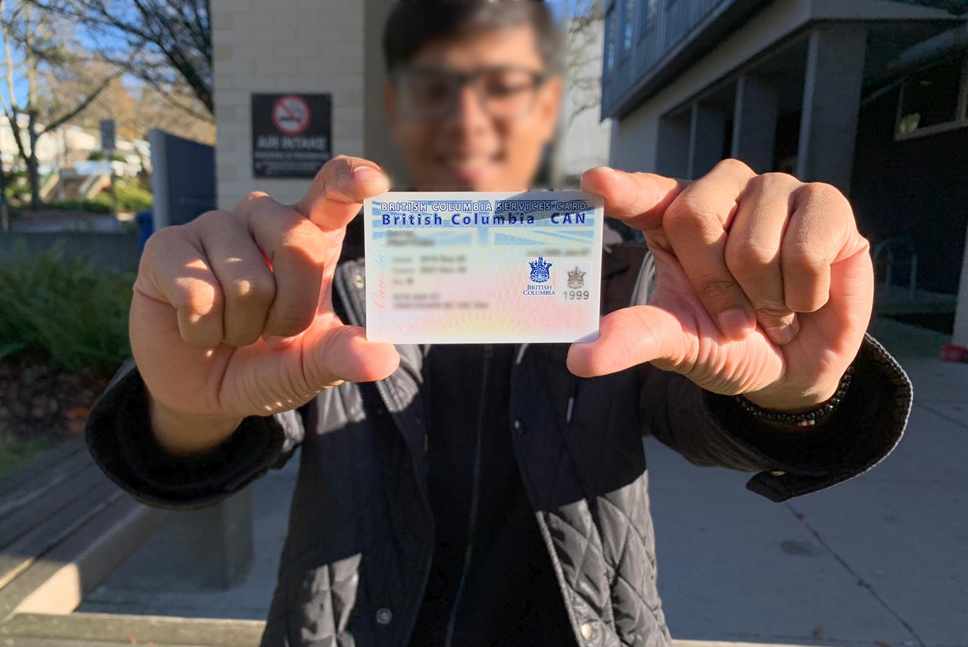
Health, Safety, and Insurance
Medical Services Plan (MSP) enrollment for permits 6+ months
Private health coverage for first 3 months if applicable
Local healthcare services and walk-in clinics
Mental health supports and counseling
Addiction and overdose prevention resources (Naloxone access)
Notes:
If your study permit is for six months or longer, you must apply for BC’s Medical Services Plan (MSP).
You may need private health coverage for the first three months before MSP starts. This is part of your enrollment at the college, and if you have any questions, please follow up with our Financial Aid Officer.
Kelowna has walk-in clinics, urgent care, and the Kelowna General Hospital.
We also provide access to counselling and mental health services, including online counselling services.
Addiction and overdose prevention resources are available — free Naloxone kits can save lives, and we encourage awareness and training. First aid is available at “The Cage,” which is also where we keep our Naloxone kit.

Slide 8

Cultural Adjustment & Inclusion
Canadian classroom culture and participation
Building community on and off campus
Respectful behaviour and anti-racism resources
Diversity and inclusion on campus
Notes:
Moving to a new country brings both excitement and challenges — it’s normal to experience culture shock.
In Canadian classrooms, participation and collaboration are encouraged — asking questions is a good thing.
Respect for diversity and inclusion is part of our campus culture. We have zero tolerance for discrimination or harassment.
We encourage you to engage with local events, clubs, and activities to feel part of the community.

Slide 9

Academic Success Resources
Attendance and progression requirements
Tutoring, workshops, and academic advising
Using the Learning Management System (Canvas)
https://tecglobal.instructure.com/login/canvas
Getting help early if struggling academically
Notes:
Attendance is important — missing too many classes can affect your academic standing and study permit compliance.
We offer tutoring, workshops, and academic advising to help you succeed. If you need Academic Support, speak to your Department Head and Student Services.
Our Learning Management System, Canvas, is where you’ll find assignments, grades, and course materials.
If you’re struggling academically, reach out early — we’re here to support you.

Slide 10

Student Services Contacts
Student Services team contact info
Department Heads and Instructors
Financial Services and Scheduling support
Emergency contacts
Notes:
Our Student Services team is here to help with personal and academic support.
Department Heads and Instructors are your go-to for program-specific questions.
Financial Services can assist with payment plans and student account questions.
Scheduling & Academic Records can help with timetables and transcripts.
Keep these contacts handy — they’re here for you.

Slide 11
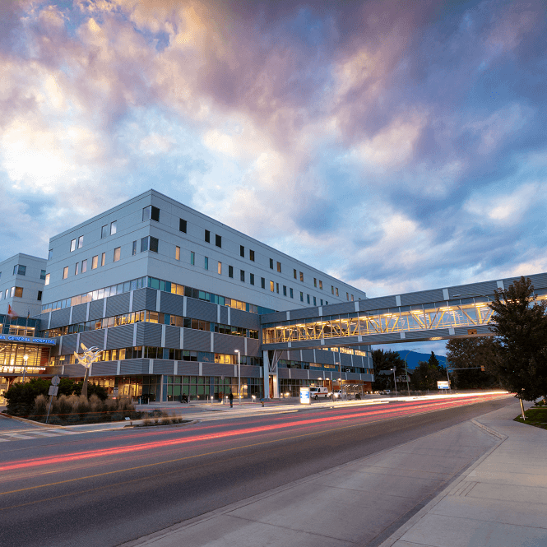
Emergencies & Crisis Support
Emergency number: 911
Campus safety and security contacts
Crisis lines: mental health, suicide prevention
Critical incident procedures
Notes:
In an emergency, call 911 for police, fire, or ambulance.
Campus safety and security contacts are available for on-site issues. Contact numbers are located in every classroom space on campus.
For mental health crises, call 988 or local crisis lines — help is available 24/7.
Our Critical Incident Policy ensures that emergencies are handled quickly and appropriately.

Slide 12
Q&A
Your questions are welcome
We are here to support your success and well-being
Notes:
We’ve covered a lot today, and I know it’s a lot to take in.
What questions do you have about studying here, living in Kelowna, or any of the topics we discussed?
Remember, you can always follow up with Student Services if something comes to mind later.
Welcome again — we’re so happy to have you here, and we can’t wait to see what you’ll accomplish.

